Slide 1
Active@ Disk Editor
Efficient Drive forensics – and it’s free!
Prepared by Edward Webber

Slide 2
Where to find it
http://www.disk-editor.org/download
Reasons to use it:
Completely free
Regular updates
Has partner file recovery app
Eliminates data location calculation errors
Reduces time to find data
Automatically translates data for multiple file systems into user-readable format

Slide 3
Main features
More than a basic hex editor

Slide 4
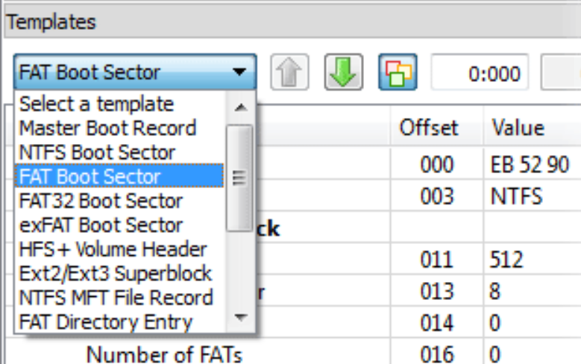
features overview
Drive Support
Hard disk drives
SSD & USB Disks
Partitions & Volumes
Files
Template Driven Data Displays
Drive Images Support
vmWare
dd images
MS Virtual PC
DIM support (disk image + metadata)
Hyperlinks
For example:
MFT records link to first cluster in data run
MBR links to partitions.
Built-in File Editor
All features are self-contained
No plug-ins needed

Slide 5
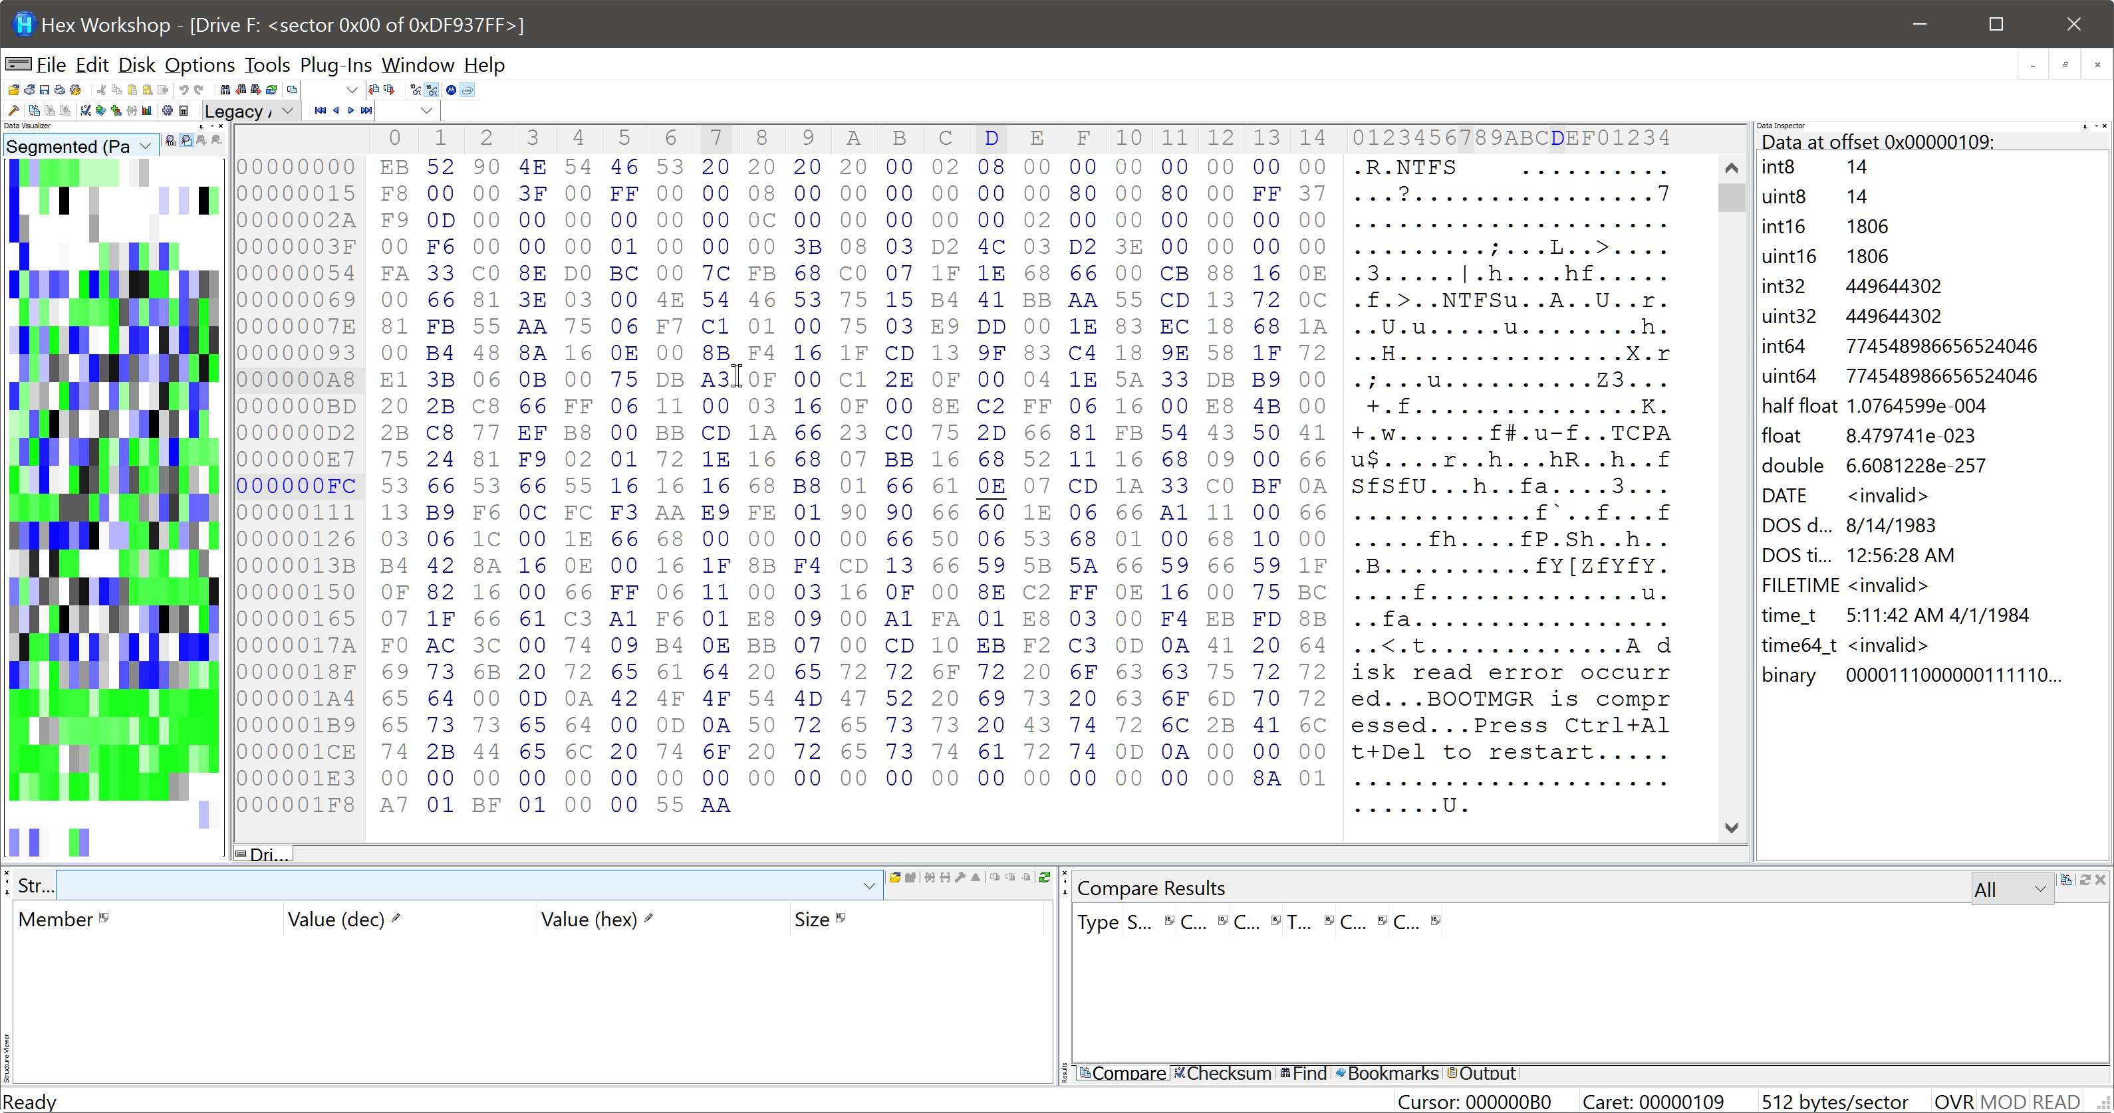
Alternative: Hex workshop
Drawbacks:
$90 per seat
No updates in two years
Lacks modern interface
Steep learning curve
No block hyperlinking
No file system templates
Manual sector calculations
Must rely on bookmarks
Wall of hex

Slide 6
Disk editor vs. Hex workshop
Feature | DE | HW
Maximum file size Partial file loading Disk sector editing Bit editing Text editor Insert / Delete bytes Bit Shifting Search Unicode | N/A YES YES YES YES YES NO YES | N/A YES YES YES NO* YES YES YES
Feature | DE | HW
File structure view Hi-res Support File Compare Find in Files Bookmarks Macro Data inspector Auto-Highlighting | YES YES YES YES YES YES YES YES | NO NO YES YES YES NO* YES NO*

Slide 7
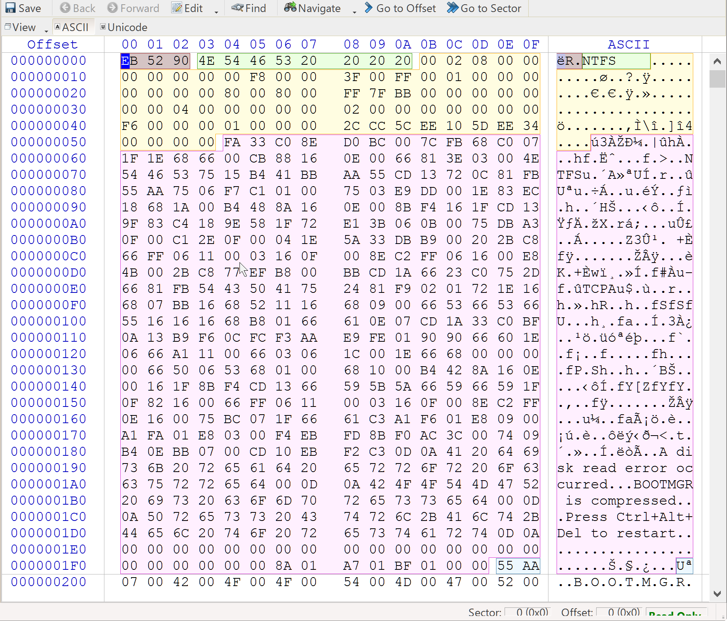
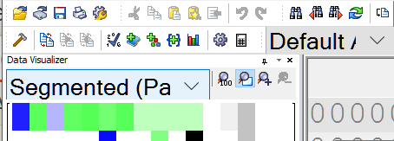
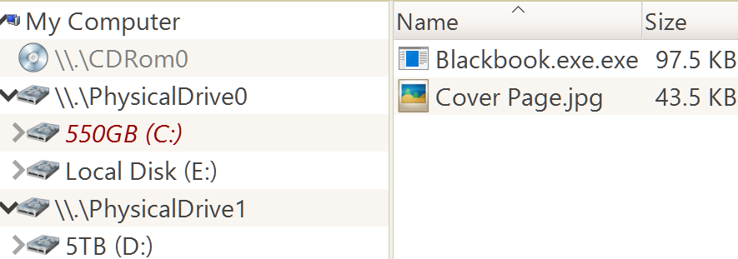
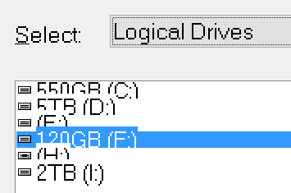
Which would you choose?
Color coded. Modern interface.
Wall of Hex. UI from the 80’s.

Slide 8
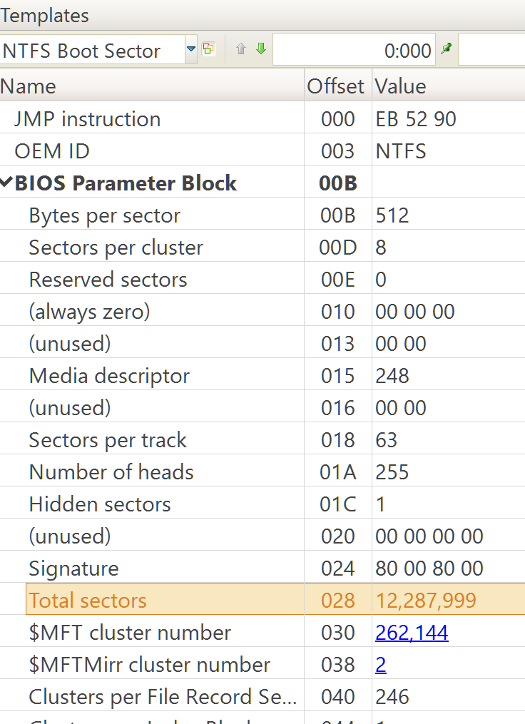
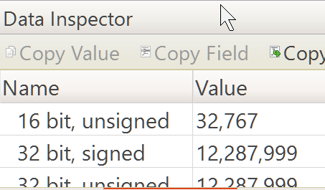
Disk Editor 6
Find the Total Sectors:
Where is it located?
What’s the value? (8 bit? 16 bit? Signed?)
MFT cluster number?
Hyperlinked

Slide 9
Hex workshop 6.8
Find the Total Sectors:
Where is it located?
What’s the value? (8 bit? 16 bit? Signed?)
MFT cluster number?

Slide 10
Forensics problem 1
Sampling the power of disk editor

Slide 11
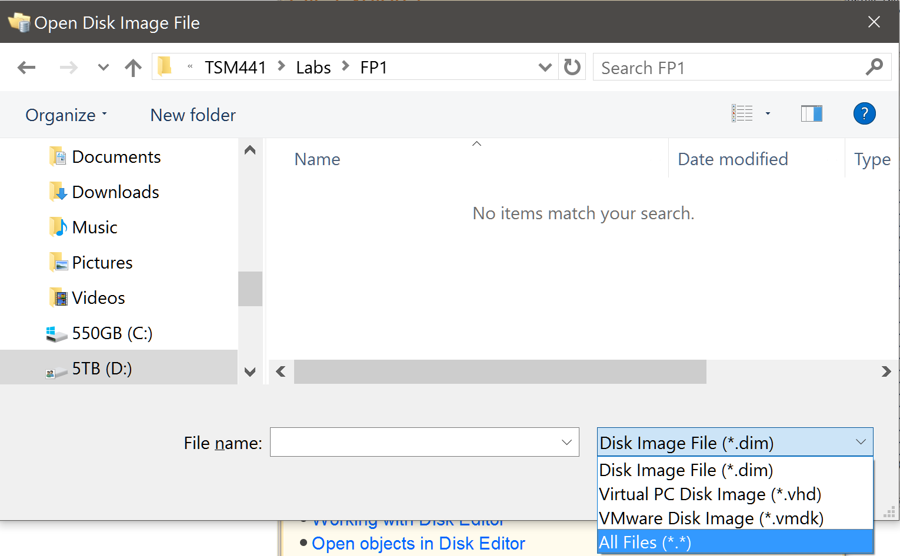
Forensics problem 1
3/30/2016 4:59 PM Open Active@ Disk Editor
3/30/2016 4:59 PM Select “open disk image”
3/30/2016 5:00 PM Select “All files” from the extension dropdown menu and open FP1.dd

Slide 12
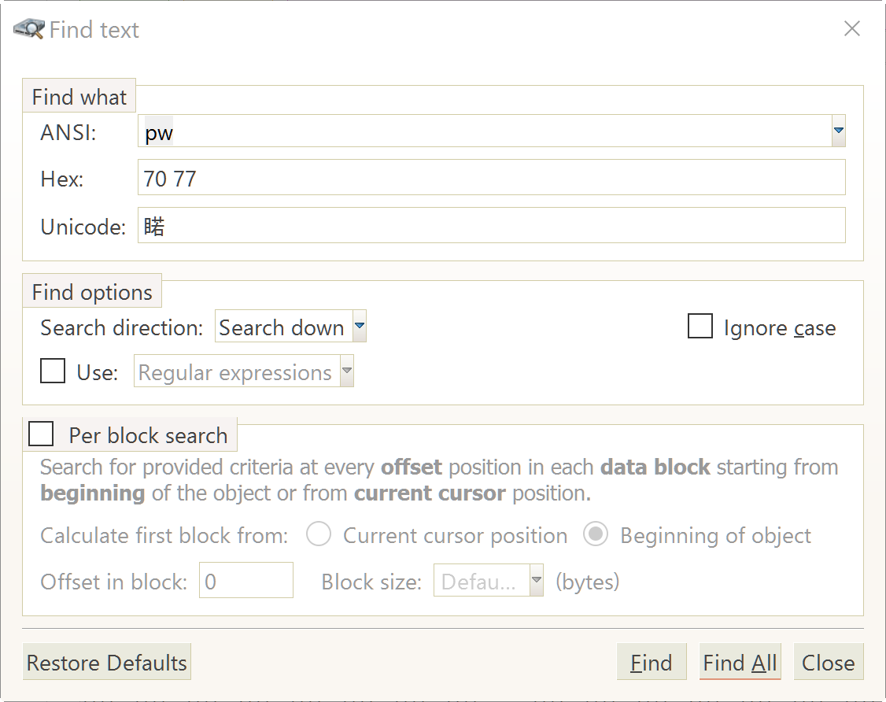
Forensics problem 1
3/30/2016 5:01 PM Click the “Find” icon, enter “pw” in the search field
3/30/2016 5:02 PM If not selected, select the “Find Results” tab in the lower left.

Slide 13
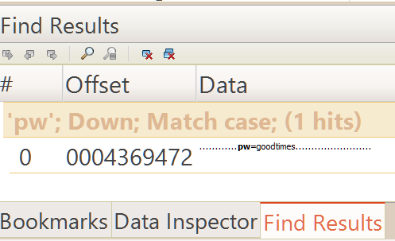
Forensics problem 1
3/30/2016 7:28 PM Select “‘pw’ Down; Match case (1 hits)”, then select “pw=goodtimes”
3/30/2016 7:31 PM Password is hidden within the RAM slack of “Cover page.jpg” image file. Should appear as “pw=goodtimes” in sector x2156 (8,534) at offset x40-4B (64-76)

Slide 14
Project 5.2 – file entry metadata
Where disk editor shines (and hex workshop nightmares begin)

Slide 15
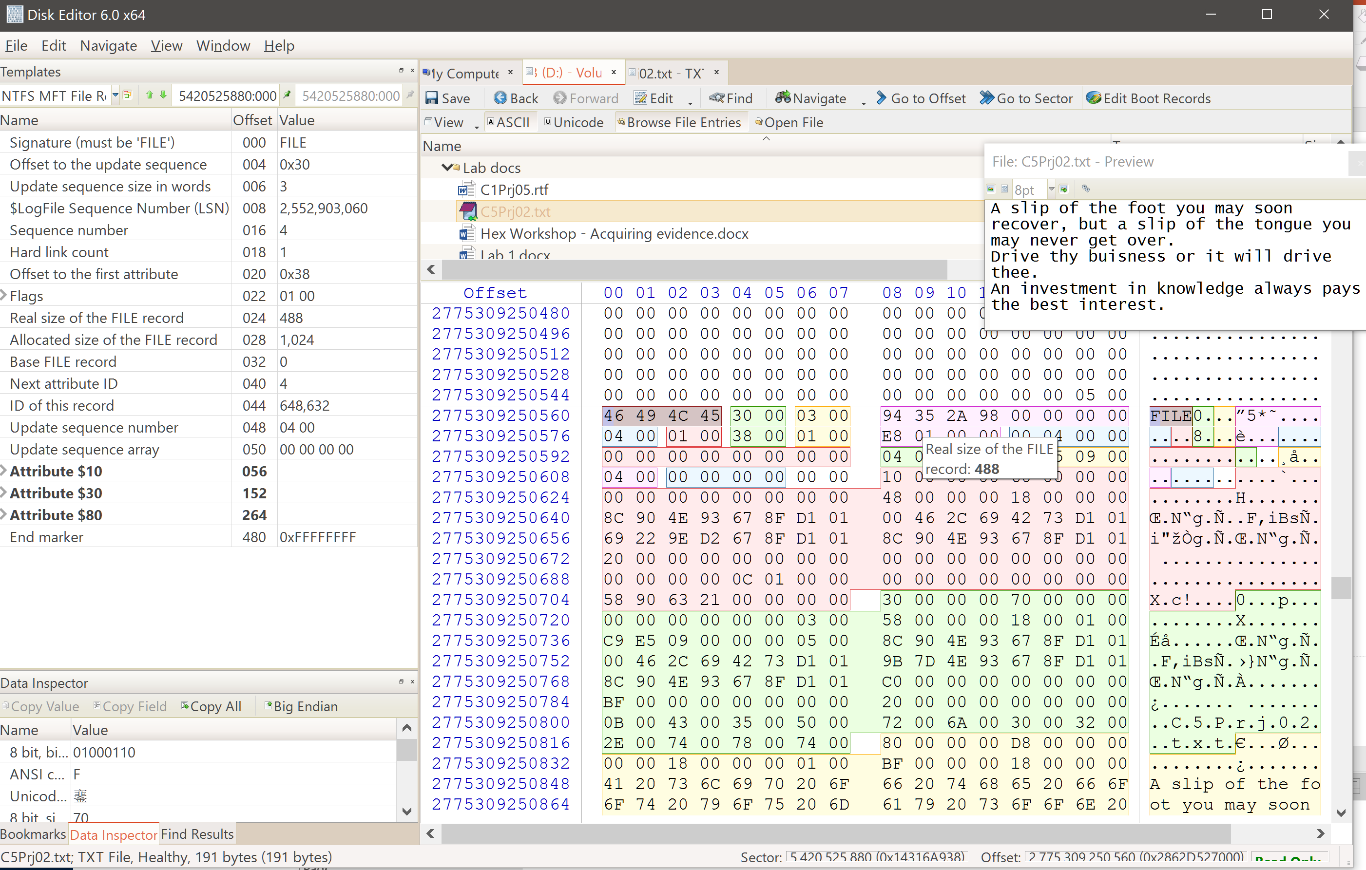
specific files
C5Prj02.txt
Contents:
“A slip of the foot you may soon recover, but a slip of the tongue you may never get over. Drive thy buisness or it will drive thee. An investment in knowledge always pays the best interest.”

Slide 16
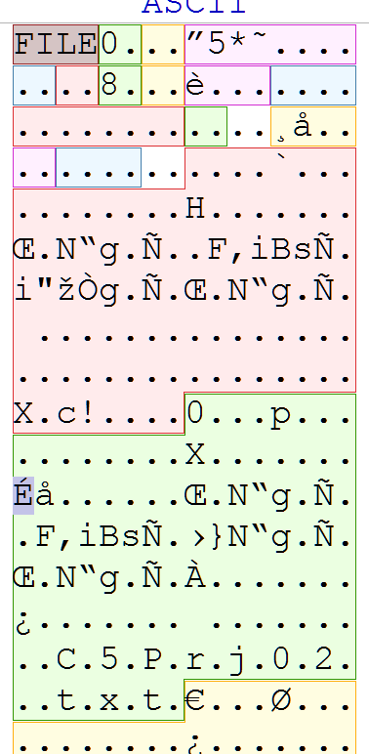
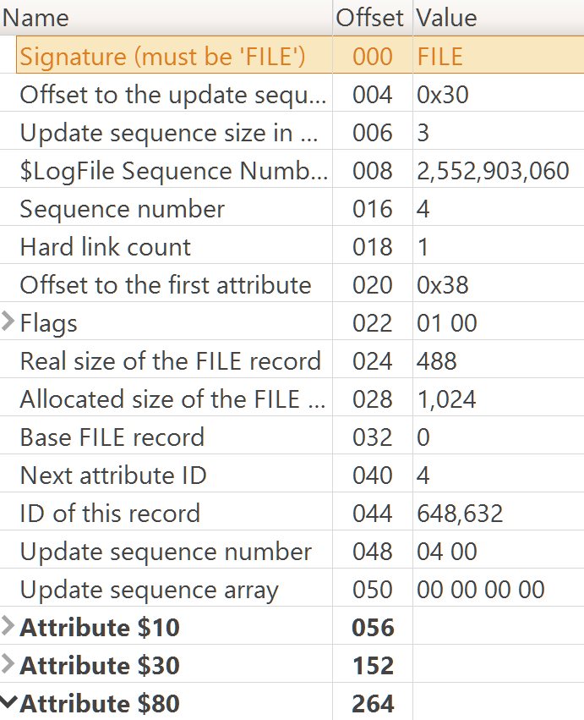
File metadata
Fully highlighted
Organized metadata structure
Attribute sections
10
30
80

Slide 17
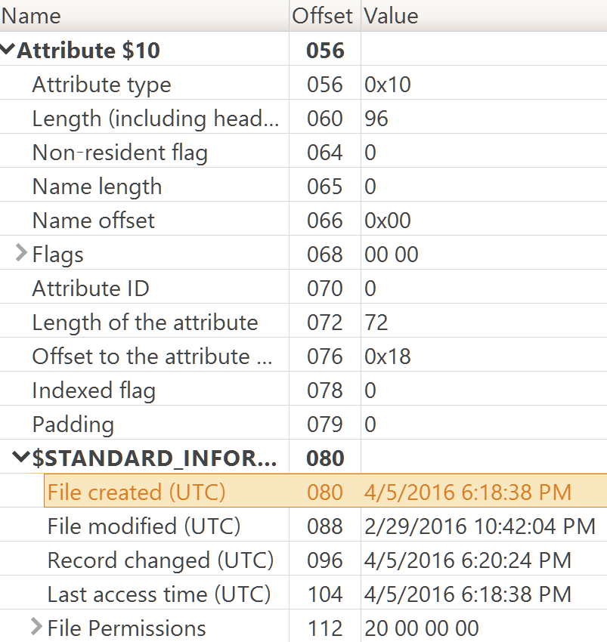
File metadata – mac times
No guessing
No math
No losing your place in a sea of hex
No human error
At-a-glance results

Slide 18
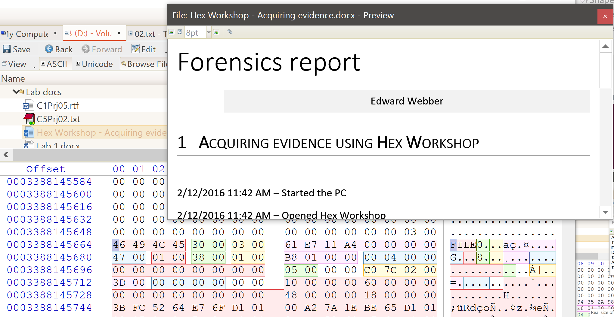
File previews
Many formats supports
Word
RTF
Excel
CSV
Text
JPG
BMP
TIFF
PNG

Slide 19
FAT32/USB File System Evaluation
Where disk editor shines (and hex workshop nightmares continue)

Slide 20
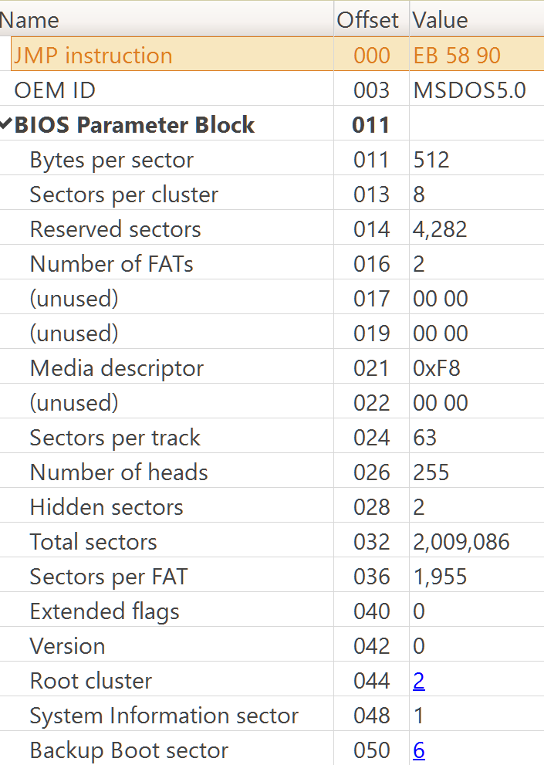
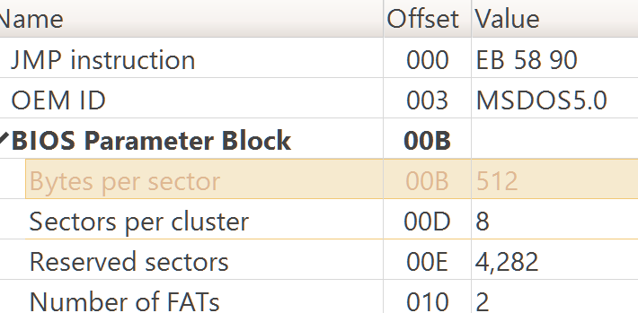
FAT32/USB File System Evaluation
Switch between Hex / Dec?
One mouse click
FAT32 Boot Sector
Automatically highlighted and parsed

Slide 21
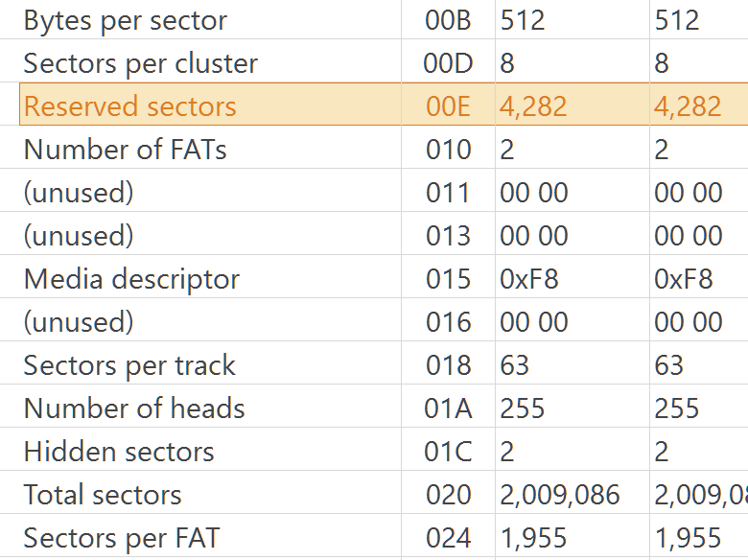
FAT32/USB File System Evaluation
Root directory entry
Where is it?
Do the math:
Sectors per FAT: 1,955
Number of FATs: 2
1955 x 2 = 3,910
Reserved sectors: 4,282
4,282 + 3,910 = 8,192
Bytes per sector: 512
Sectors per cluster: 8
Root cluster: 2
512 x 8 x 2 = 8,192

Slide 22
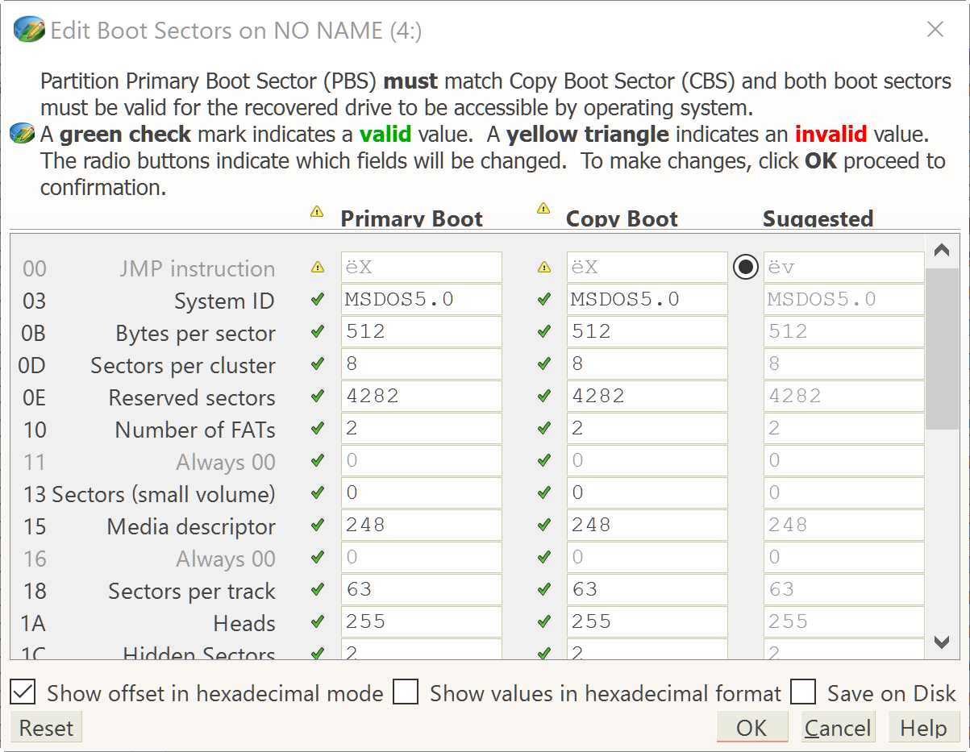
FAT32/USB File System Evaluation
FAT32 Boot Sector
Boot sector validator
Checks for out of spec values

Slide 23
Summary
Active@ Disk Editor 6
FREE!
Easy to learn
Minimal training required
Prevents hex reading mistakes
Little endian, Big endian – All automatically calculated
Quick shortcuts to content
Clickable hyperlinks to relevant sectors
Easy file editing
Did I mention FREE?

Slide 24
Questions?
Active@ Disk Editor
http://www.disk-editor.org/download
Presentation by: Edward webber

